Slide 1

Fundamentals of Economics
M.M.L.C.Gunathilake
Senior Lecturer gr ii
Department of Management and Finance
General Sir John Kotelawala Defence University
Ratmalana

Slide 2
Lesson 04
Law of Supply

Slide 3
SUPPLY
Supply is the amount of a good that sellers are willing and able to sell.
Quantity supplied is a full description of how the quantity supplied of a commodity responds to changes in its price.
Notes:
25

Slide 4
Individual firm’s supply schedule and supply curve
Price of
Ice-Cream
Cones
Supply curve
$3.00
Price of Ice-cream cone | Quantity of Cones supplied
$0.00 0.50 1.00 1.50 2.00 2.50 3.00 | 0 cones 0 1 2 3 4 5
2.50
1. An increase
in price . . .
2.00
1.50
2. . . . increases quantity
of cones supplied.
1.00
0.50
0
1
2
3
4
5
6
7
8
9
10
11
12
Quantity of Ice-Cream Cones

Slide 5
Market supply and individual supplies
Price of ice-cream cone | Amal |  | Neela |  | Market
$0.00 0.50 1.00 1.50 2.00 2.50 3.00 | 0 0 1 2 3 4 5 | + | 0 0 0 2 4 6 8 | = | 0 0 1 4 7 10 13

Slide 6
Market supply and individual supplies
Amal’s
supply
+
Neela’s
supply
=
Market
supply
Price of
Ice
Cream
Cones
Price of
Ice
Cream
Cones
Price of
Ice
Cream
Cones
S_{Ben}
$3.00
$3.00
$3.00
S_{Market}
S_{Jerry}
2.50
2.50
2.50
2.00
2.00
2.00
1.50
1.50
1.50
1.00
1.00
1.00
0.50
0.50
0.50
0
1
2
3
4
5
6
7
8
9
10
11
12
0
1
2
3
4
5
6
7
0
2
4
6
8
10
12
14
16
18
Quantity of Ice-Cream Cones
Quantity of
Ice-Cream Cones
Quantity of Ice-Cream Cones

Slide 7
Supply determinants/ deciding factors
Price of the product
Production Technology
Price of the production factors
Price of other products (production substitutes)
Objective of the firm
Number of Producers or firms
Future price expectations
Taxes and subsidies

Slide 8
Law of Supply
The law of supply states that, the quantity supplied of a good rises when the price of the good rises, as long as all other factors that affect suppliers’ decisions are unchanged.

Slide 9
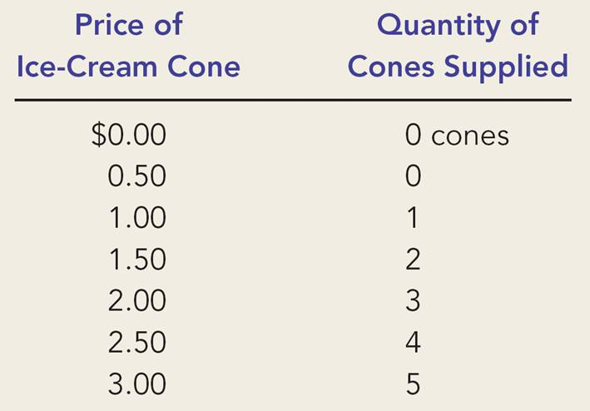
Law of Supply—
Explanation
How can we make sense of the numbers in Amal’s supply schedule?
The best guess is that his costs must be something like the cost schedule below.
A specific ice-cream cone | It’s cost ($)
1st | 0.75
2nd | 1.35
3rd | 1.75
4th | 2.30
5th | 2.85
6th | 3.10
In this way, the Law of Supply follows from the assumption of Increasing Costs (or, Diminishing Returns)

Slide 10
Supply Shift
How could supply have increased?
Supply Schedule
Price ($) | Quantity Supplied
 | Before | After
0.00 | 0 | 0
0.50 | 0 | 1
1.00 | 1 | 2
1.50 | 2 | 3
2.00 | 3 | 4
2.50 | 4 | 5
3.00 | 5 | 6
Ice-cream cone | It’s cost ($)
 | Before | After
1st | 0.75 | 0.45
2nd | 1.35 | 0.85
3rd | 1.75 | 1.45
4th | 2.30 | 1.95
5th | 2.85 | 2.45
6th | 3.10 | 2.90
Anything that reduces production costs, shifts supply to the right.

Slide 11
Shifts in the Supply Curve…
… are caused by changes in
  Input prices
  Technology
  Number of sellers (short run)
The market supply will shift right if
  Raw materials or labor becomes cheaper
  The technology becomes more efficient
  Number of sellers increases
Notes:
27

Slide 12
Shifts in the Supply Curve:
What causes them?
Price of
Ice-Cream
Supply curve,
S
3
Supply
Cone
curve,
S
1
Supply
Decrease
curve,
S
2
in supply
Increase
in supply
0
Quantity of
Ice-Cream Cones

Slide 13
THE ELASTICITY OF SUPPLY
Price elasticity of supply is a measure of how much the quantity supplied of a good responds to a change in the price of that good.
Price elasticity of supply is the percentage change in quantity supplied resulting from a percent change in price.

Slide 14

The Price Elasticity of Supply
(a) Perfectly Inelastic Supply: Elasticity Equals 0
Price
Supply
$5
4
1. An
increase
in price . . .
0
100
Quantity
2. . . . leaves the quantity supplied unchanged.

Slide 15
The Price Elasticity of Supply
(b) Inelastic Supply: Elasticity Is Less Than 1
Price
Supply
$5
4
1. A 22%
increase
in price . . .
0
100
110
Quantity
2. . . . leads to a 10% increase in quantity supplied.

Slide 16
The Price Elasticity of Supply
(c) Unit Elastic Supply: Elasticity Equals 1
Price
Supply
$5
4
1. A 22%
increase
in price . . .
0
100
125
Quantity
2. . . . leads to a 22% increase in quantity supplied.

Slide 17
The Price Elasticity of Supply
(d) Elastic Supply: Elasticity Is Greater Than 1
Price
Supply
$5
4
1. A 22%
increase
in price . . .
0
100
200
Quantity
2. . . . leads to a 67% increase in quantity supplied.

Slide 18
The Price Elasticity of Supply
(e) Perfectly Elastic Supply: Elasticity Equals Infinity
Price
1. At any price
above $4, quantity
supplied is infinite.
$4
Supply
2. At exactly $4,
producers will
supply any quantity.
0
Quantity
3. At a price below $4,
quantity supplied is zero.

Slide 19
Determinants of Elasticity of Supply
Ability of sellers to change the amount of the good they produce.
  Beach-front land is inelastic.
  Books, cars, or manufactured goods are elastic.
Time period.
  Supply is more elastic in the long run.

Slide 20
Equilibrium

Slide 21
Interaction of demand and supply
We have seen what demand and supply are
We have seen why demand and supply may shift
Now it is time to say something about how buyers and sellers collectively determine the market outcomeTo do this, we assume equilibrium

Slide 22
Equilibrium
We assume that the price will automatically reach a level at which the quantity demanded equals the quantity supplied.

Slide 23
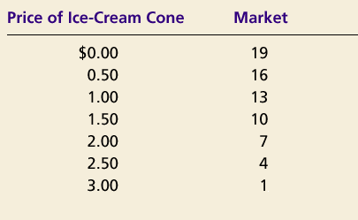
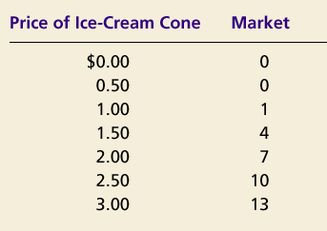
SUPPLY AND DEMAND TOGETHER
Demand Schedule
Supply Schedule
At $2.00, the quantity demanded is equal to the quantity supplied!
Notes:
36

Slide 24
Equilibrium of supply and demand
Price of
Ice-Cream
Cones
Supply
$3.00
2.50
Equilibrium
price
Equilibrium
2.00
1.50
1.00
Equilibrium
quantity
Demand
0.50
0
1
2
3
4
5
6
7
8
9
10
11
12
Quantity of Ice-Cream Cones

Slide 25
Markets Not in Equilibrium
(a) Excess Supply
Price of
Ice-Cream
Supply
Cone
Surplus
$2.50
2.00
Demand
0
4
7
10
Quantity of
Quantity
Quantity
Ice-Cream
demanded
supplied
Cones

Slide 26
Markets Not in Equilibrium
Surplus
  When price exceeds equilibrium price, then quantity supplied is greater than quantity demanded
    There is excess supply or a surplus
    Suppliers will lower the price to increase sales, thereby moving toward equilibrium

Slide 27
Markets Not in Equilibrium
Shortage
  When price is less than equilibrium price, then quantity demanded exceeds the quantity supplied.
    Suppliers will raise the price due to too many buyers chasing too few goods, thereby moving toward equilibrium.

Slide 28
Markets Not in Equilibrium
(b) Excess Demand
Price of
Ice-Cream
Supply
Cone
$2.00
1.50
Shortage
Demand
0
4
7
10
Quantity of
Quantity
Quantity
Ice-Cream
supplied
demanded
Cones

Slide 29
Equilibrium
Law of supply and demand
  The price of any good adjusts to bring the quantity supplied and the quantity demanded for that good into balance.

Slide 30
Producer Surplus
Difference between the market price received by the seller and the price they would have been prepared to supply at:
Price received – linked to factor cost(Rent, Wages & Interest) + element of normal profit(Entrepreneur’s share).
Producer surplus = abnormal profit.

Slide 31
Consumer Surplus
Consumer Surplus
  The difference between the maximum amount a consumer is willing to pay for a good and the amount actually paid.

Slide 32
Consumer Surplus
Price
($ per
ticket)
Consumer Surplus
for the Market Demand
20
19
18
17
16
Consumer
Surplus
15
14
Market Price
13
Actual
Expenditure
Demand Curve
0
1
2
3
4
5
6
Rock Concert Tickets

Slide 33
Producer Surplus
Price (Rs)
S
Market price = Rs.10
10
At Rs.10, suppliers willing to offer
60 for sale
Total Revenue = blue area
Rs.10 x 60 = Rs.600
6
Some suppliers would have offered
35 for sale at Rs.6:
Producer surplus = 35 x Rs.4 = Rs.140
Gold area = Producer surplus
35
60
Quantity Supplied

Slide 34
Supply, Demand, and Government Policies
In a unregulated market system with open entry and exit, market forces establish equilibrium prices and quantities.
While equilibrium conditions may be efficient, not everyone will be satisfied with the outcomes.
  Consumers
  Producers
Notes:
2
2

Slide 35
Government Intervention in Markets
Buffer Stocks
Income Guarantee Schemes and Price Controls

Slide 36
Buffer Stocks

Slide 37
Price Controls...
Are usually enacted when policymakers believe the market price is unfair to buyers or sellers.
Result in government-created price ceilings or price floors.
Notes:
3
3

Slide 38
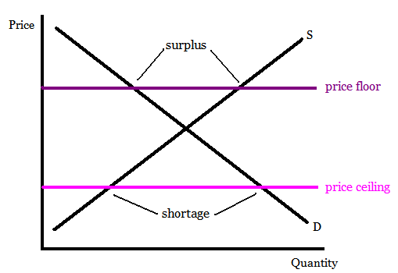
Price Ceilings & Price Floors
Price Ceiling
A legally established maximum price at which a good can be sold.
Price Floor
A legally established minimum price at which a good can be sold.
Notes:
4
4

Slide 39
Price Ceilings
Two outcomes are possible when the government imposes a price ceiling:
◆ The price ceiling is not binding if set above the equilibrium price.
◆ The price ceiling is binding if set below the equilibrium price, leading to a shortage.
Notes:
5
5

Slide 40
Thank you

